Slide 1


The Best Practice:
Selecting a Professional Consultant
Presented by John Gamble, P.Eng.
to Public Services and Procurement Canada
Ontario Region
January 17 2019

Slide 2
Voice for the business of consulting engineering in Canada
Represents over 400 firms across Canada
Member firms collectively employ over 60,000 Canadians
Most members firms are SMEs
Members provide a wide range of engineering and other professional services to public and private clients
Federation of 12 provincial and territorial associations (including Consulting Engineers of Ontario)

Slide 3
The potential of public procurement
Fulfilling government mandates and commitments
Access to expertise and experience
Providing flexibility and savings
Creating jobs and opportunities for Canadians
Growing businesses and creating tax revenue
Encouraging innovation
Fairly sharing risk and reward

Slide 4
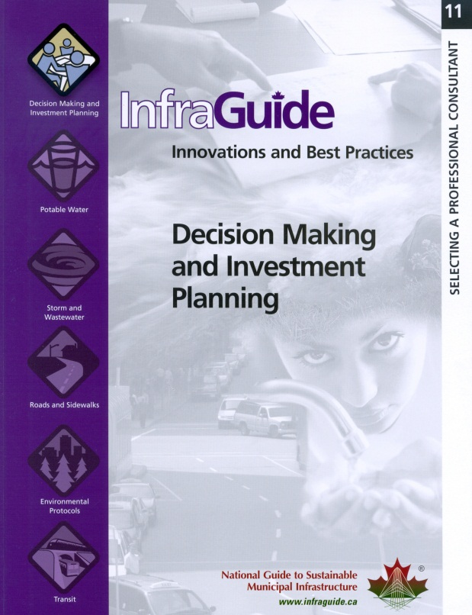
Our recommendation
Public agencies adopt Selecting a Professional Consultant, the procurement best practice developed in 2006 by the National Guide to Sustainable Municipal Infrastructure (InfraGuide)

Slide 5
Selecting a Professional Consultant
National Guide to Sustainable Municipal Infrastructure
Developed by the public sector… for the public sector:
Federation of Canadian Municipalities
National Research Council
Infrastructure Canada
Canadian Public Works Association
Based on extensive interviews and research
Recommends “competitive qualifications-based process” (QBS)
National network of experts in public and municipal infrastructure:
Publisher of over 50 “Best Practice” documents
Notes:
An InfraGuide Best Practice
Developed by the public sector – for the public sector
Based on extensive interviews and research
Recommends “competitive qualifications-based process” (QBS)
What is InfraGuide?
National Guide to Sustainable Municipal Infrastructure
National network of experts in public and municipal infrastructure:
Federation of Canadian Municipalities
National Research Council
Infrastructure Canada
Canadian Public Works Association
Publisher of over 50 “Best Practice” documents

Slide 6

Our mutual goals
TIMELY DELIVERY
FISCAL RESPONSIBILITY
QUALITY & INNOVATION
PUBLIC
INTEREST

Slide 7
Total life-cycle costs
Operations and Maintenance
(O&M)
Construction
Engineering & Architecture

Slide 8
Opportunities to add value
Level of Influence
Operations & Maintenance
Design
Construction
Time

Slide 9
Opportunities to add value
Cost of Making Changes
Operations & Maintenance
Design
Construction
Time

Slide 10


Procurement is the key
Establishing common objectives and desired outcomes
Understanding cost-benefit-risk relationships
Clarifying roles and responsibilities
Selecting the right team for the right job
Identifying required resources (cost and schedule)
The RIGHT price is the BEST price!
Notes:
Establishing common objectives and desired outcomes
Understanding cost-benefit-risk relationships
Clarifying roles and responsibilities
Selecting the right team for the right job
Identifying required resources

Slide 11

Common procurement challenges…
Process becomes an end unto itself – rather than a means to an end
Treats professional services as a commodity
Discourages innovation
Assumes all proponents are equal
Takes extended period to award
Is used to justify pre-decided outcome
Confuses value with low price
Notes:
Becomes an ends unto itself – rather a means to an end
Treats professional services as a commodity
Has vague/open-ended objectives and scope
Assumes all proponents are equal
Takes extended period to award
Is used to justify pre-decided outcome
Confuses value with low price

Slide 12

A good procurement system…
Clearly defines objectives and scope
Evaluates what distinguishes proponents
Fairly shares risk and reward
Rewards proposals that add value
Uses a short list where necessary – Proposals are expensive
Considers project life-cycle
Focuses on best value – not lowest price
Notes:
Clearly defines objectives and scope
Evaluates what distinguishes proponents
Meaningfully delineates scores
Rewards proposals that add value
Uses a short list where necessary – Proposals are expensive
Considers project life-cycle
Focuses on best value – not lowest price

Slide 13

What’s wrong with lowest price?
Rewards firms that minimally interpret project scope (e.g. commit fewer resources, less experienced staff)
Penalizes firms that propose innovation
Penalizes firms that anticipate complexities
Significant life-cycle savings sacrificed in favour of modest short-term savings
Knowing “too much about the client’s needs can be a disadvantage”
Notes:
Rewards firms that minimally interpret project scope (e.g. commit fewer resources, less experienced staff)
Penalizes firms that propose innovation
Penalizes firms that anticipate complexities
Significant life-cycle savings sacrificed in favour of modest short-term savings
Knowing “too much about the client’s needs” is a disadvantage”

Slide 14
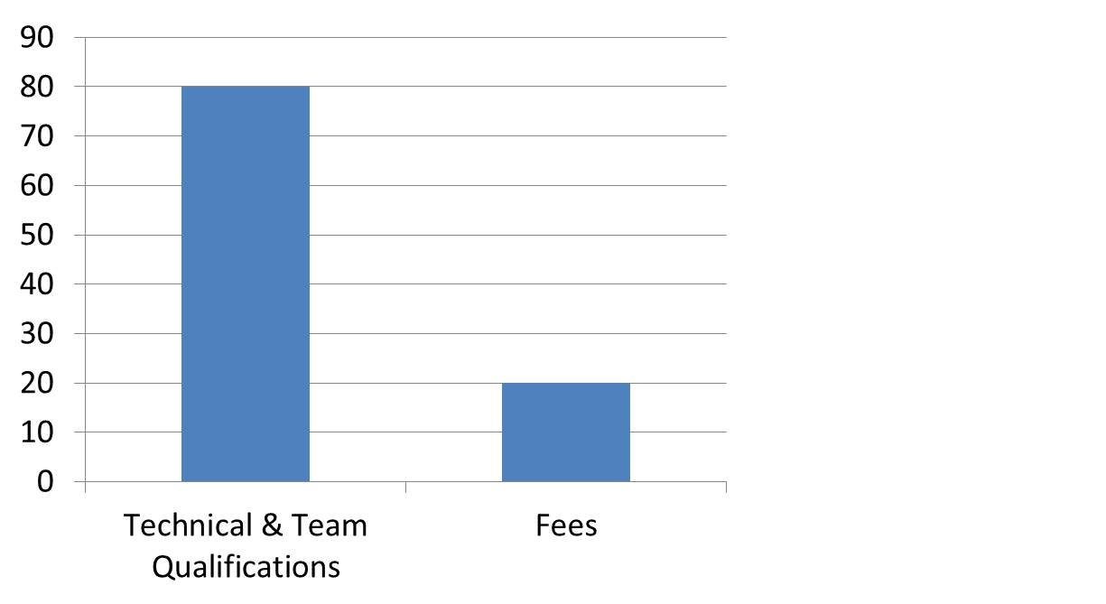
But what if fees are only part of the evaluation?
“But fees are only 20%
of the weight!”

Slide 15
Actual distribution of scores
5 points
Fee score can
still dominate
qualifications!
20 points

Slide 16
How does the Best Practice work?
Request for Qualifications
Evaluate & Rank Consultants
Request for Proposals
Select Highest-Ranked Consultant
Refine and Clarify Scope
Negotiate Fee Agreement
Award assignment
Monitor Performance; Provide Feedback
Notes:
An InfraGuide Best Practice
Developed by the public sector – for the public sector
Based on extensive interviews and research
Recommends “competitive qualifications-based process” (QBS)
What is InfraGuide?
National Guide to Sustainable Municipal Infrastructure
National network of experts in public and municipal infrastructure:
Federation of Canadian Municipalities
National Research Council
Infrastructure Canada
Canadian Public Works Association
Publisher of over 50 “Best Practice” documents

Slide 17





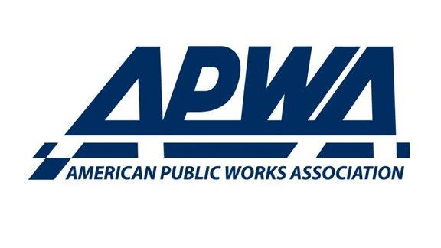

Who else supports QBS?
Notes:
International Federation of Consulting Engineers (FIDIC)
Engineers Canada
Royal Architecture Institute of Canada
American Institute of Architects
American Council of Engineering Companies
American Public Works Association

Slide 18


Who uses this approach?
QBS legislated by the US federal government and 46 state governments
Municipalities across the US
Cities of Calgary, London and Coquitlam
Pilot Programs:
  MetroLinx
  Alberta Transportation
  PSPC (National Capital Region)
Notes:
QBS legislated by the US federal government and 46 state governments
Municipalities across the US
City of Calgary, City of London and Metrolinx
Quebec legislation now requires its provincial agencies to use QBS for architectural and engineering services

Slide 19
An Analysis of Issues
Pertaining to QBS
Georgia Institute of Technology and University of Colorado (2009)
Reviewed over 200 projects across the USA
93% of clients expressed high or very high satisfaction with consultants selected using QBS
QBS reduced construction change orders costs by 70%
QBS reduced schedule overruns by 20%
QBS provided better ability to address societal issues or stakeholder concerns
Notes:
Georgia Institute of Technology and University of Colorado (2009)
Reviewed over 200 projects across the USA
93% of clients expressed high or very high satisfaction with consultants selected using QBS
QBS reduced construction cost growth by 70%
QBS reduced schedule slippage by 20%
QBS provided better ability to address societal issues or stakeholder concerns

Slide 20

An Analysis and Comparison of Maryland and Florida Systems
American Institute of Architects (1985)
Compared QBS (Florida) to Qualifications/Price-Based System (Maryland)
Maryland’s process was significantly more expensive and took longer
Maryland’s Qualifications/Price-Based System resulted in low-bidder winning 85% of the time
Florida viewed as “preferred client”
Maryland viewed as “client of last resort”
Notes:
American Institute of Architects (1985)
Compared QBS (Florida) to Qualifications/Price-Based System (Maryland)
Maryland’s process was significantly more expensive and took longer
Maryland’s Qualifications/Price-Based System resulted in low-bidder winning 85% of the time
Florida viewed as “preferred client”
Maryland viewed as “client of last resort”

Slide 21
QBS for the Procurement of Professional A/E Services
Polytechnic University of New York (2002)
“QBS offers significant advantages over competitive bidding”
“QBS… is cost-competitive and has the best potential to reduce long-term project costs”
Notes:
Polytechnic University of New York (2002)
“QBS offers significant advantages over competitive bidding”
“QBS… is cost-competitive and has the best potential to reduce long-term project costs”

Slide 22
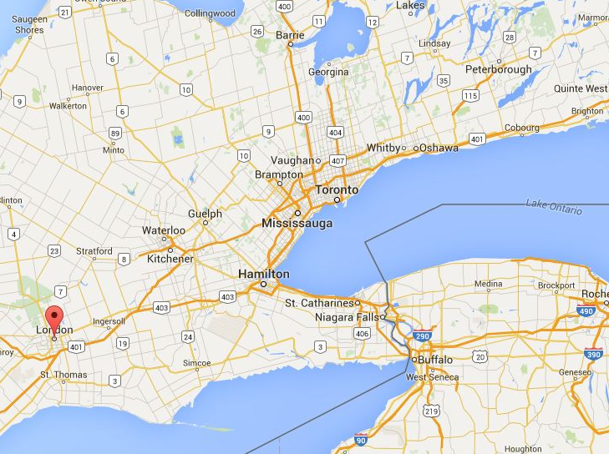
Canadian Example: City of London
After pilot program, QBS introduced in 2007
Focus on quality and life-cycle costs, not consultant fees
Design the solution for the problem
Quicker into design – 3 month saving
Staff savings – 200 to 400 hours
Profession savings - $70k to $100k
Source: City Manager 2008
Notes:
After pilot program, QBS introduced in 2007
Focus on quality and life-cycle costs, not consultant fees
Design the solution for the problem
Quicker into design – 3 month saving
Staff savings – 200 to 400 hours
Profession savings - $70k to $100k
Source: City Manager 2008

Slide 23
Canadian Example: City of London
Getting better quality work from the same consultants with much less effort
More control over project scope
The best consultants can be competitive under QBS
City is a preferred client
More senior staff involvement provides
Better oversight
Source: City Manager 2008
Notes:
Getting better quality work from the same consultants with much less effort
More control over project scope
The best consultants can be competitive under QBS
City is a preferred client
More senior staff involvement provides
Better oversight
Source: City Manager 2008

Slide 24
QBS outcomes
The right team for the right job
Realistic schedules and budgets
Fewer change orders and disputes
Better business relationship between parties
Better service, better quality & better value for taxpayers

Slide 25
Current situation
PSPC have been working with design and construction stakeholders in recent months to get familiarized with QBS
We have jointly examined other international and provincial jurisdictions
Projects that used QBS for procurement were shown to have both lower construction costs and schedule delays
PSPC issued two QBS procurements as pilot in 2018

Slide 26

“Not everything that counts can be counted;
and not everything that can be counted counts.”
- Albert Einstein, Famous Genius

Slide 27
130 Albert St. Suite 420
Ottawa, Ontario K1P 5G4
Tel: 613-236-0569
info@acec.ca
www.acec.ca
THANK YOU!

